Slide 1

Notes:
1st slide (Mandatory)

Slide 2
Transaction Analysis

Slide 3
Transactional Analysis (TA) is a psychological theory and therapy that can be connected to the broader concept of emotional intelligence (EI). Developed by psychiatrist Eric Berne, TA focuses on understanding and improving communication and relationships. It provides a framework for analyzing human interactions and behavior, making it applicable to the development of emotional intelligence.
Transaction Analysis

Slide 4
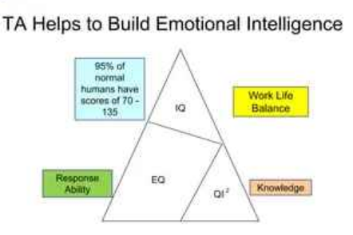
Here's how certain aspects of TA relate to emotional intelligence:
Ego states
Transaction
Strokes
Games
Life script

Slide 5
Ego States in Transactional Analysis
Parent Ego State: Critical and Nurturing Aspects
Adult Ego State: Rational and Problem-Solving
Child Ego State: Emotional and Spontaneous Responses

Slide 6
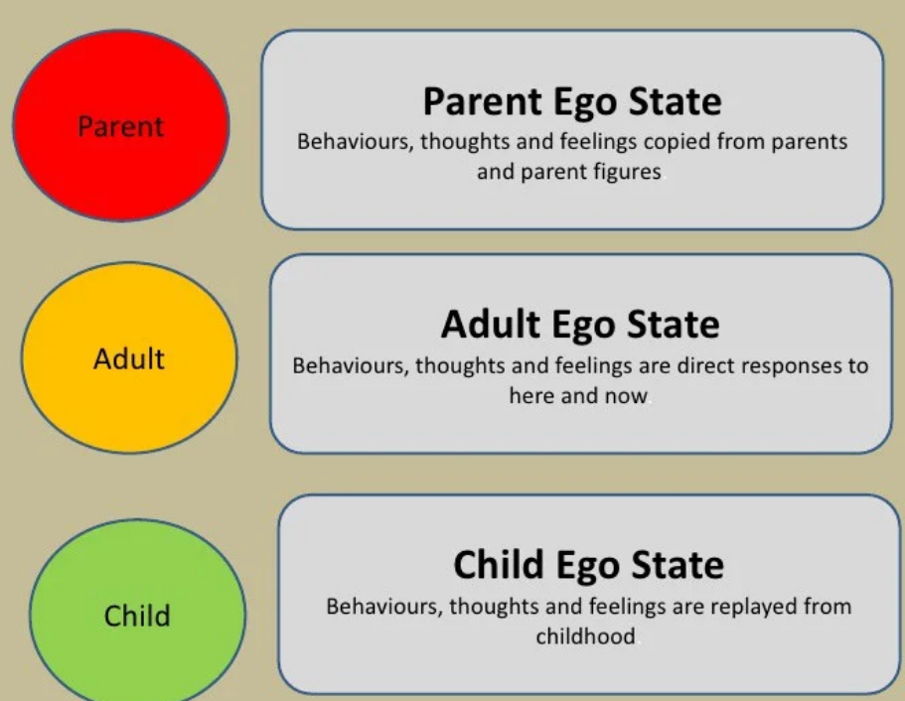

Slide 7
1. Parent Ego State: Critical and Nurturing Aspects
Critical Parent (CP)
In this aspect, individuals express thoughts, beliefs, and attitudes that resemble those of authority figures from their past, such as parents or other influential figures.
It can manifest as judgment, rules, and criticism.
Example: A person saying, "You should always do it this way; that's how it's supposed to be done."
Notes:
Ans : C

Slide 8
1. Parent Ego State: Critical and Nurturing Aspects
Nurturing aspects:
This aspect involves expressions of care, support, and guidance.
It represents the positive and encouraging messages received from caregivers.
Example: Offering words of encouragement like, "You did a great job, I'm proud of you."
Notes:
Ans : C

Slide 9
Adult Ego State: Rational and Problem-Solving
In the Adult Ego State, individuals engage in logical thinking, objective analysis, and problem-solving without being influenced by emotions or past experiences.
Example: Analyzing a situation at work, considering facts and figures, and making a decision based on rational thought.

Slide 10
Child Ego State: Emotional and Spontaneous Responses
Adapted Child (AC):
This aspect reflects behaviors and feelings learned from interactions with others during childhood.
It can involve compliance or rebelliousness, depending on the learned responses.
Example: Someone reacting to criticism with a submissive, compliant attitude.

Slide 11
Child Ego State: Emotional and Spontaneous Responses
Natural Child (NC):
This represents the spontaneous and unfiltered emotions and behaviors that individuals experienced in childhood.
It can be joyful, curious, or rebellious.
Example: Laughing wholeheartedly at a funny situation without inhibition.

Slide 12
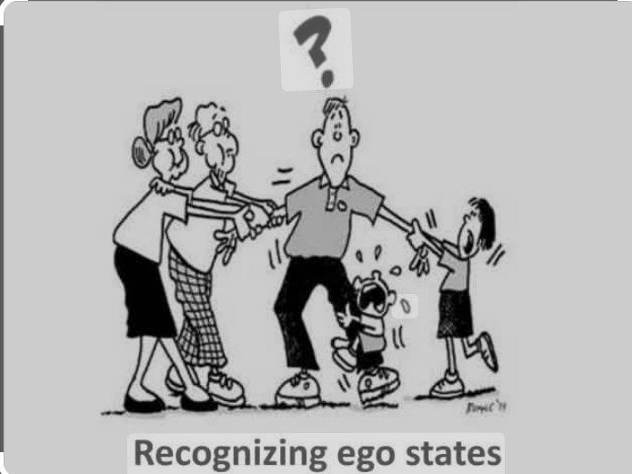
Importance of Recognizing Ego states :
Understanding motivations
Enhanced communication skills
Conflict Resolution
Building Rapport
Promoting Emotional intelligence

Slide 13
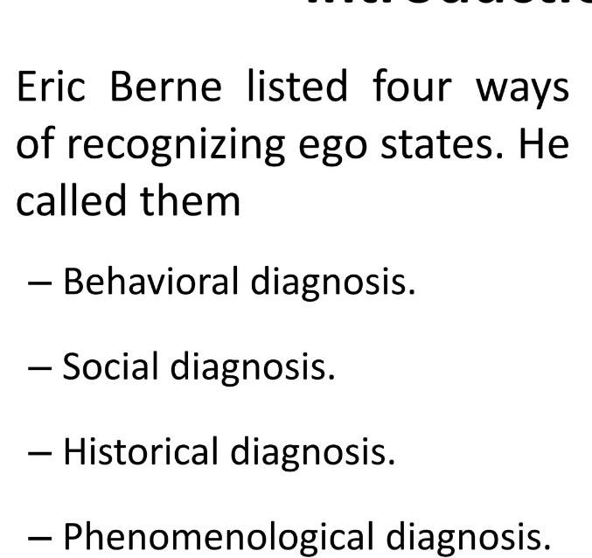

Slide 14
Transactions in Communication
Transactional Analysis views communication as a series of transactions, where individuals send and receive messages.
A transaction consists of a stimulus and a response, forming the building blocks of interpersonal communication.
These transactions occur between different ego states, influencing the nature and quality of communication.

Slide 15
The ‘3 Rules of Communication’ in TA
1st Rule of Communication
So long as transactions remain complementary, communication can continue indefinitely.
2nd Rule of Communication
When a transaction is crossed, a break in communication results, and one or both individuals will need to shift ego states in order for the communication to be re-established
3rd Rule of Communication
The behavioural outcome of an ulterior transaction (one where two messages are sent at the same time; one overt social and one covert psychological) is determined at the psychological level and not at the social level.

Slide 16
Strokes in Transactional Analysis

Slide 17
Strokes in Transactional Analysis
Eric Berne defined a stroke as the “fundamental unit of social action”. A stroke is a unit of recognition, when one person recognizes another person. A stroke can be physical, verbal or non-verbal and so could be a hand shake, a compliment or a nod of the head. It could also be a “Hello”, “Go away!” or a dismissive wave of the hand. All of these acknowledge that the other person exists.

Slide 18
Introduction of strokes
Berne introduced the idea of strokes into Transactional Analysis based upon the work of Rene Spitz, a researcher who did pioneering work in the area of child development. Spitz observed that infants deprived of cuddling, touching and handling (in other words, not receiving any physical strokes) were more likely to experience emotional and physical difficulties.
Berne took Spitz’s observations of these infants and developed theories about the needs of adults for strokes. Berne postulated that adults do need physical contact just like infants, but have learned to substitute other types of recognition for physical stimulation. So while an infant needs cuddling, an adult craves a smile, a wink, a hand gesture, or some other form of recognition. Berne defined this requirement of adults to receive strokes by the term “recognition-hunger” or “stroke-hunger”. He said that we are all desperately seeking strokes from others and that a lot of what we do is in order to be stroked.
Understanding how people give and receive both positive and negative strokes, and changing the unhealthy patterns of stroking are important aspects of TA.

Slide 19
Verbal Strokes: Verbal expressions of recognition, praise, or acknowledgment. Examples include compliments, positive feedback, or expressions of gratitude.
Non-Verbal Strokes: Gestures, facial expressions, or other non-verbal cues that convey acknowledgment. A smile, a nod, or a pat on the back are examples of non-verbal strokes.
Conditional and Unconditional Strokes: Conditional strokes are based on specific conditions or achievements, while unconditional strokes are offered regardless of any particular accomplishment.

Slide 20
Positive Strokes: Affirmative expressions that convey recognition, appreciation, or support. Positive strokes contribute to building self-esteem, fostering positive relationships, and reinforcing desirable behaviors.
Negative Strokes: Critical or disapproving expressions that can diminish self-esteem and strain relationships. While constructive feedback is essential, excessive negative strokes may hinder personal growth and harm relationships.

Slide 21
“conditional” and “unconditional” strokes are concerned, Berne stated that unconditional strokes are related to what you are (strokes for being), while conditional strokes are about what you do (strokes for doing). Below are some examples of the different types of strokes:
 | Positive Strokes (Compliments) | Negative Strokes (Insults)
Unconditional (What you are / Being) | “I love you.”“I like you.”“You’re wonderful!” | “I hate you.”“I don’t like you.”“You’re an idiot!”
Conditional (What you do / Doing) | “I like you when you smile.”“I like your coat.”“You look pretty!”“Well done on taking the exam.”“You’ve done a great job!” | “I don’t like you when you are sarcastic.”“Your clothes look grubby.”“You are really stupid for getting fired!”“Your work is unacceptable!”
Of course, strokes can be further classified in a number of ways by differentiating between:
verbal and non-verbal strokes,
physical or psychological strokes
internal (strokes from self as in self-praise and other ways of self-stimulation) and external (strokes we receive from others).

Slide 22
Stroke Filters
People often have a stroke filter – a mental filter that operates unconsciously all of the time. This filter only allows some strokes to reach the person, while distorting or completely blocking others. They only let in strokes which they think they are allowed to let in. For example, if we have always been told we are the clever one and our brother is the creative one, then we are likely to accept strokes for being clever, but not for being creative. In the same way, we might allow ourselves to receive strokes for being clever but keep out strokes for being good looking.
If a girl considers herself to be intelligent, but (falsely) believes she is ugly, the filter will allow the intelligence strokes to pass, but will block or distort any positive strokes relating to her beauty.
A comment such as, “I see you have a new coat” can also be changed to either a positive or a negative stroke depending on the receiver’s filter. For example, when a person says to him or herself, “He likes my coat”, it is a positive stroke. When the person says to him or herself, “He doesn’t like my coat”, it becomes a negative stroke.

Slide 23
Positive Strokes
How often do you:
 | Give positive strokers to others? | Refuse to give the positive strokes others expect from you? | Accept positive strokes? | Ask others for positive strokes?
Usually
Always
Frequently
Often
Rarely
Almost Never

Slide 24
Negative Strokes
How often do you:
 | Give negative strokes to others? | Refuse to give the negative strokes | Accept negative strokes? | Ask others (even indirectly) for negative strokes?
Usually
Always
Frequently
Often
Rarely
Almost Never

Slide 25
Games in Transactional Analysis
In Transactional Analysis, "games" refer to recurring, often unconscious patterns of behavior that people engage in to fulfill certain psychological needs.
These patterns can be repetitive and may involve subtle or overt manipulations in communication and relationships.
In the Transactional Analysis “Okay Corral” can be linked to GAME for which Jim Davis TSTA developed the simple and helpful model.

Slide 26
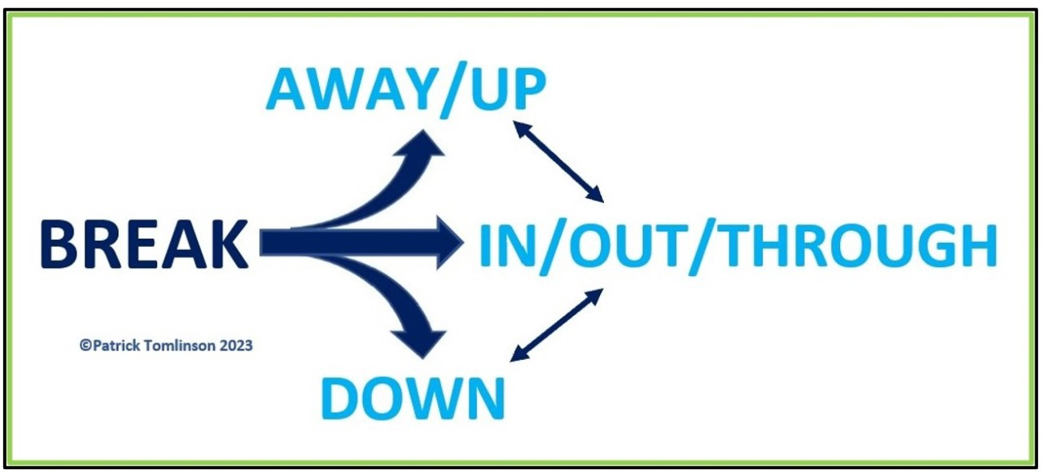
Breaking Negative Patterns
Identify Triggers
Pause and Reflect
Communication Skills
Seek Feedback
Set Boundaries
Replace Negative Habits with Positive Ones
Professional Support

Slide 27
Life Script in Transactional Analysis
In Transactional Analysis, a life script is an unconscious life plan that individuals form in early childhood based on their experiences, observations, and interactions with significant others.
The life script is shaped by messages, beliefs, and decisions made during childhood. These messages can be explicit or implicit, and they influence an individual's perception of themselves, others, and the world
The life script operates beneath the level of conscious awareness.
Individuals may not be fully aware of the script, yet it guides their thoughts, feelings, and behaviors throughout life.

Slide 28
How Past Experiences Influence Behavior
Parental Influence
Early Experiences
Decisions and Beliefs
Repetition of Patterns

Slide 29
How to Heal From the Past
Establish boundaries. This can mean something different for everyone, but the main point is to give yourself time to heal and to move ahead at your own pace
Acceptance. The past is a done-deal. We can’t change it. And being stuck in the past is only hurting our potential in the present. By accepting that the past is over, it allows us to grieve and to release the pain that we may have been carrying with us.
Practice Mindfulness. The practice of mindfulness is about teaching ourselves how to stay in the present and to calm our mind when experiencing emotional triggers.
Have a Reset Button. We are human, and that means we are perfectly imperfect. As with any new skill, they take time to develop and master
Disconnect. Balance is key when working on self-improvement. Being okay with disconnecting from social media or from friends or family for a while as you work on healing is about self-care

Slide 30
Life positions
Life positions are a key concept in Transactional Analysis (TA). They represent basic beliefs about oneself and others, formed in early childhood based on interactions with caregivers and the environment.
These positions influence how individuals perceive themselves, others, and the world around them, and consequently, how they behave in relationships.
The four basic life positions are:
I'm OK, You're OK (get on with) : This is the healthiest position, characterized by trust, acceptance, and a positive outlook.

Slide 31
I'm OK, You're not OK (get rid of ): This position involves feeling superior to others, often leading to blaming, criticizing, and controlling behaviour.
I'm not OK, You're OK (get away from ): This position involves feeling inferior to others, leading to self-doubt, dependence, and a tendency to seek approval.
I'm not OK, You're not OK (get nowhere with): This is the most negative position, characterized by feelings of hopelessness, despair, and a lack of trust in oneself and others.

Slide 32
Benefits of Integrating TA and EI
Improved Communication
Enhanced Relationships
Personal Growth
Effective Conflict Resolution
Enhanced Leadership Skills
Increased Emotional Resilience
Positive Organizational Culture
Personal and Professional Growth

Slide 33
Life script questionnaire
Consider your earlier childhood with your primary care givers and role models. For each person of significant influence, consider these questions in turn:
What did they say when they complimented you as a child?
What did they say to you when they were upset or criticising you?
What stories or messages were you given about life, death, marriage, love, your birth, men, women, gender?

Slide 34
Exploring your rewards and sanctions
What behaviours were you routinely awarded / rewarded for as a child?
What behaviours were you routinely chastised for?
How often did you feel rushed by the adults around you?
How did your caregivers respond to displays of emotion or affection? Were you free to show emotion or were you compelled to put a brave face on things for example?
How easy was it for you to make mistakes and experiment, or did you find you were routinely chastised for getting things ‘wrong’ or making a mess?

Slide 35
THANK YOU

